Slide 1
Introduction to Social Media Analytics (Lec 7)
Hao PENG
Department of Data Science
City University of Hong Kong
https://haoopeng.github.io/

Slide 2
Agenda for this week
Audience analytics
User demographics
Psychological traits
Political affiliations
Health informatics
Notes:
In text analysis, we deal with individual post
In user modeling, we deal with each user’s collection of posts

Slide 3
Audience analytics
Sentiment and emotion are “text-level” characteristics
Lots of user-level social / psychological attributes
Demographics (age, race, gender, income, etc)
Psychological traits (personality, sexual orientation, prosociality)
Political affiliation, user interests, communities, incivility, etc.
Mental health/state (empathy, depression, stress, etc)
Healthy lifestyle (weight lose, eating disorder, early riser)
…

Slide 4
Audience analytics
Audience analytics aims to understand the demographic & psychographic characteristics of social media users such as audience size, location, gender, age, and interests, etc.
By leveraging audience analytics, businesses & org. can gain invaluable insights into who their followers are, where they come from, and what they care about, enabling the creation of more targeted and effective marketing strategies.

Slide 5
Examples of audience analytics
Product Development Insights—A gaming company discovers through audience analytics that a substantial number of its X followers are female gamers interested in role-playing games (RPGs). This insight leads to the development of a new RPG with strong female lead characters, directly catering to this audience segment.
Geographical Targeting—A coffee chain uses audience analytics to find out that a large number of its Facebook followers are located in northeastern of United States. This insight guides the chain's decision to run a special promotion in those regions, capitalizing on the high concentration of followers there.

Slide 6
Demographic analysis
Demographics refer to the statistical characteristics of human populations and particular groups within it. This includes:
Age: Knowing the age distribution of audience can help tailor content to be more relatable and engaging.
Gender: Understanding the gender breakdown can inform product offerings and effective marketing messages.
Race/Ethnicity: One of the most important social identities in racially diverse countries such as the U.S.
Location: Location data helps in understanding geographical representation and can help design marketing campaigns.

Slide 7
Gender
Biological/sex-based definition
Refers to biological characteristics (female vs. male)
Often used in medical treatments
Social/cultural definition
Refers to social roles, behaviors, and expectations societies assign to individuals based on their perceived sex.
They can vary across cultures and history.
Gender Identities
Binary (women vs. men)
Non-binary, mixed, unisex
Gender prediction: https://genderize.io/

Slide 8
Race, nationality, ethnicity
Race:
Based on appearance (Asian, Black, Hispanic, White, etc.)
Could be broken down into finer categories (East vs. South Asian)
Nationality:
Objective, but hard to know without self-identities
Asian --> Chinese, Japanese, Korean, etc.
White --> England, French, Germany, Italian, etc.
Ethnicity:
Nationality is about country’s flag; ethnicity is about cultural roots
Can differ from one’s nationality due to migration and immigration
True vs. perceived identity
Perceived attributes can often be inferred from name
In many cases, they are not the same (e.g., Michael Jackson)
Which one should you use? In what contexts?

Slide 9
Socioeconomic status (SES)
Education
Occupation
Income level
SES: a concept used by economists & sociologists. The measure combines a person‘s work experience and their or their family’s access to economic resources & social position relative to others.
Social class: refers to a person’s relatively stable cultural background, whereas SES refers to one’s current social & economic situation which is more changeable over time.
https://en.wikipedia.org/wiki/Socioeconomic_status

Slide 10
Case study on user demographics
How to understand the demographic composition of a brand's social media followers using techniques in SMA?
Tool Setup: Use APIs to access audience data from a brand’s Facebook or Instagram account.
Data Collection: Extract data on age, gender, and location.
Data Analysis: Create visualizations (pie charts for gender distribution, age histograms, and heat maps for location) to display the demographic data.
Reporting: Write a report on how the brand‘s content might be tailored to better suit the diverse demographics of its users.

Slide 11
Psychographic analysis
Psychographics delve into the psychological attributes of an audience, including personality traits, values, interests, and lifestyles. This can significantly enhance user understanding:
Interests: By analyzing what your audience is interested in, you can tailor content to their preferences. A travel agency, for instance, may discover through audience analytics that their followers are keen on sustainable travel, prompting them to share more eco-friendly travel options.
Lifestyle: Understanding the lifestyle of your audience can help in creating relatable content. If a luxury watch brand finds that its Instagram followers are interested in luxury lifestyle beyond just watches, including fine dining and high-end cars, it might expand its content to cover these areas as well.

Slide 12
Big Five personality model
The Big Five model is widely used in psychology for its reliability and ability to predict user behavior across various contexts.
Openness: Creativity and curiosity; high openness means embracing new ideas, low means preferring routine.
Conscientiousness: Organization and responsibility; high is diligent and goal-focused, low is impulsive.
Extraversion: Sociability and energy; extraverts are outgoing, introverts are reserved.
Agreeableness: Compassion and cooperation; high is kind and trusting, low is competitive.
Neuroticism: Emotional stability; high is anxious and moody, low is calm and resilient.

Slide 13
Predicting personality traits
Supervised learning (e.g., logistic regression, random forests) can be used to predict Big Five traits from social media activity:
Self-assessment tools: The Big Five is typically measured using standardized questionnaires like the Big Five Inventory.
Data collection: Use APIs to collect user data with permission.
Feature engineering: Extract features like linguistic patterns (e.g., LIWC, positive/negative sentiment for Agreeableness), posting frequency (Extraversion), topic diversity (Openness), and profile metadata (e.g., bio descriptions and avatars).
Accuracy: Studies (e.g., Kosinski et al., 2013) show that models trained on social media data can predict personality traits with correlations of ~0.4-0.6 to self-reported scores.

Slide 14
Applications of Big Five
User segmentation: Cluster users by personality traits to tailor content or ads. For example, high Openness users may respond to creative, innovative campaigns, while high Conscientiousness users prefer structured, goal-oriented content.
Engagement prediction: Forecast user interactions (e.g., likes) by including features of personality traits. Extraverts are more likely to share content, while conscientious users may engage more often with professional or educational posts.
Example: Build a ML model to predict which users will retweet based on their Extraversion and Openness scores.

Slide 15
Political affiliation
Political affiliation refers to an individual’s self-alignment with a political party, ideology, or movement.
Liberal: Advocates for systemic change, social equality, and policy intervention to promote welfare and rights. On social media, these users often engage with progressive hashtags.
Conservative: Emphasizes tradition, limited government, and preserving established norms. Often prioritizes social stability, economic freedom, and cultural norms.
Independent: Resists rigid ideological alignment, favoring issue-specific positions over ideological loyalty.
Populist: Focuses on representing ordinary people against perceived elites, often emphasizing anti-establishment.

Slide 16
Predicting political affiliations
Useful features for predicting political affiliations:
Linguistic cues: Words, phrases, and sentiment in user posts. Liberals often use inclusive terms (e.g., “equity,” “freedom”); Conservatives favor patriotic language (e.g., “heritage”).
Hashtag and topics: Frequency of interactions with political content. Left-leaning users may engage with social justice hashtags. Topics can signal affiliation (e.g., #BLM for Liberals).
Network features: Following or interacting with accounts of known affiliations (e.g., following progressive politicians for Liberals, authoritative leaders for Conservatives).
Profile Metadate: Bio description & profile image. Terms like “patriot” (Conservative) & “activist” (Liberal) are strong signal.

Slide 17
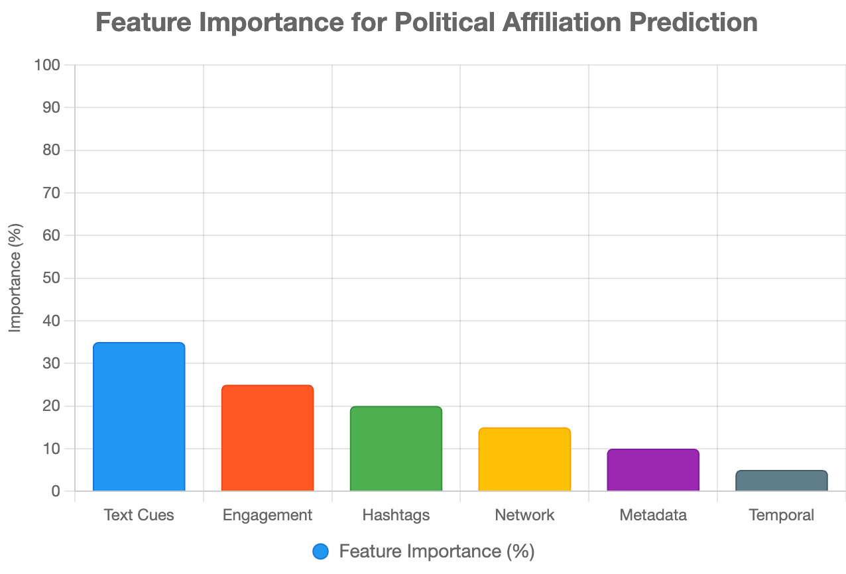
Predicting political affiliations

Slide 18
Health informatics
Research in this area focuses on using social media data to predict physical & mental health issues:
Depression, anxiety, suicide risk, etc.
Empathy, sexual abuse, anonymity
Social support, help seeking on Reddit, etc.
Healthy lifestyle (weight losing, pro-eating disorder)

Slide 19
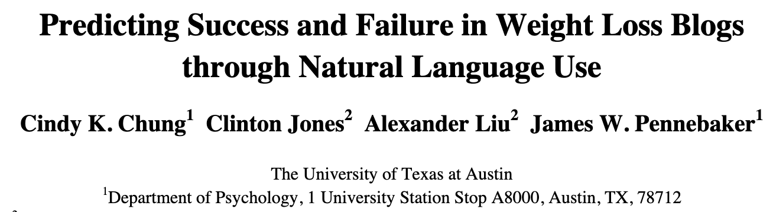

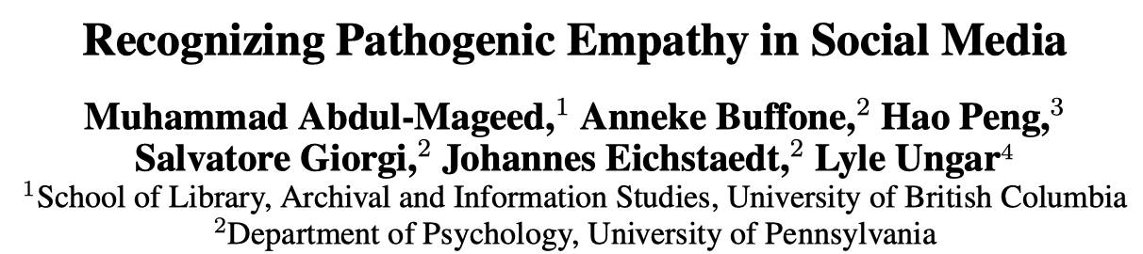
Empathy, depression, weight loss

Slide 20
Predicting mental health outcomes
Leverage machine learning & NLP tools to predict mental health using social media data (e.g., posts, comments, engagement):
Self-assessment tools: use crowdsourcing to compile a set of social media users who report being diagnosed as depressed; measure their DV based on standard psychometric instrument.
Data collection: Use APIs to collect user data with permission.
Feature engineering: Extract and measure their behavioral attributes such as social engagement, emotion, language use, linguistic styles, ego network, mentions of using medications.
Correlational analysis: Most studies found that social media contains useful signals for predicting onset of mental issues.
Accuracy is not good enough! Can be used as monitoring tools.

Slide 21
Course notes
Midterm questions review now!
Raise grading issues in class and via email
Return exam paper after class (or 0 score)
Don’t spread the question paper online!
User modeling V2 next week (W9)
HW2 will be released next week
Due in two weeks (W11)
Social media analysis V1 next week
Will use Team-Based Learning (TBL) setting
New location: CIC G-001 (map)

